Slide 1

B I O W E A V E
Your biology deserves
better than a generic
supplement.
Individual biology, illuminated.
April 2026 | Confidential

Slide 2
OUR PURPOSE
Build medical-grade AI to power the most effective longevity system ever created for an individual.
Bioweave is an AI Health OS — a system that takes your blood, DNA, and lifestyle data, and builds a personalised supplement formulation that adapts as your biology changes. No two formulations are alike, because no two biologies are.
bioweave
CONFIDENTIAL
1

Slide 3
WHY WE EXIST
Thousands of compounds discovered over centuries.
Millions of peer-reviewed studies.
8 billion unique biologies.
Everyone has imperfect DNA and imperfect lifestyle factors. The science to address them exists — scattered across research papers, clinical trials, and centuries of discoveries.
But no system connects what science knows to what your body actually needs
— until now.
bioweave
CONFIDENTIAL
2

Slide 4
CONTENTS
The Bioweave solution
01
Why This Matters
05
Competitive Position
The science and the story
Why we win
02
The Business Opportunity
06
Proof
Market size and timing
What we've built
03
Our Solution
07
What's Next
The AI Health OS
Roadmap and ambition
04
The Brand
BioGlyph and product
bioweave
CONFIDENTIAL
3

Slide 5
SECTION 01
Why This Matters
The science, the story, and the scale
bioweave
CONFIDENTIAL
4

Slide 6
THE PROBLEM
The numbers are clear
60%
23,000
99.5%
of Blueprint users experienced side effects
in trials
ER visits per year from
supplement reactions
carry at least one actionable
pharmacogenomic variant
as reported, NYT 2024
NEJM 2015
Swen et al., The Lancet, 2023
bioweave
CONFIDENTIAL
5

Slide 7
THE INSIGHT
Your DNA and biomarkers can determine which compounds help, harm, or do nothing.
Recent advances in nutrigenomics show that genetic variants in key metabolic pathways — MTHFR, COMT, VDR, CYP enzymes — determine how your body processes, absorbs, and utilises specific nutrients. A supplement that helps one person can be ineffective or harmful for another.
Source: Livingstone et al., 2021; Nutrigenomics & Personalised Nutrition, Annual Review
bioweave
CONFIDENTIAL
7

Slide 8
“
I harmed myself with 'the right' supplements. MTHFR + COMT variants that conflict — standard methyl-B12 triggered an arrhythmia. Overstacked GABA production created dizziness and derealisation.
David Trewern, Founder
bioweave
CONFIDENTIAL
6

Slide 9
WHO NEEDS CUSTOM
Almost everyone needs a bespoke protocol
15-20%
40-50%
25-30%
~3%
Dangerous — standard stacks cause harm
Risky — wrong forms, potentially harmful
Wasteful — wrong forms, wasting money
Standard OK —
the rarest group
bioweave
CONFIDENTIAL
8

Slide 10

SECTION 02
The Business Opportunity
A $10B market with no personalised player
bioweave
CONFIDENTIAL
9

Slide 11
THE MARKET
$10B and growing
IM8 — $100M ARR in 12 months
Blueprint — $20M day 1
AgeMate — $1.1M/mo
Generic longevity stack.
Subscription model.
Same formula for everyone.
No biomarker data.
David Beckham-backed.
Celebrity-endorsed stacks.
One-size-fits-all formulations.
No personalisation.
Bryan Johnson's protocol.
Sold out on launch.
His regimen, not yours.
No DNA integration.
All growing. None personalised.
bioweave
CONFIDENTIAL
10

Slide 12

B I O W E A V E
bioweave
Samantha’s stack.
(Not David Beckham’s.)

Slide 13
OUR BELIEFS
What We Believe
Science and data can now - and should drive health decisions, not marketing
Your biology is unique — your supplements should be too
Less is more — if there is not reasonable evidence of beneficial outcomes, it’s not included
Transparency builds trust — every ingredient, every reason
AI can connect data and patterns that humans can’t. Humans have accountability that AI doesn’t. We leverage both.
AI technology will continue to evolve —
making Bioweave architecture self-improving
Quarterly reformulation keeps pace with your changing biology
bioweave
CONFIDENTIAL
11

Slide 14
SECTION 03
Our Solution
The AI Health OS
bioweave
CONFIDENTIAL
12

Slide 15
THE PLATFORM
The AI Health OS
TEST
ANALYSE
DECIDE
EXECUTE
MEASURE
ADAPT
Blood, DNA,
lifestyle data
→
AI pattern
recognition
→
Personalised
formulation
→
Custom sachet
manufacture
→
Track biomarker
changes
→
Reformulate
quarterly
PERSONAL APP
Dashboard &
Chat
A continuous loop — not a one-time purchase. Your formulation evolves as your biology changes.
bioweave
CONFIDENTIAL
13

Slide 16
THE ENGINE
Scientific AI Engine
7 Specialist Agents
Synthesiser + Critic
Multi-layer safety process
Each domain — heart, brain,
gut, hormones, fitness, genes,
mind — has a dedicated AI
agent with deep expertise.
A meta-agent combines
recommendations and a critic
agent challenges every choice
for safety and efficacy.
Every formulation receives
a compound safety score.
Interaction checks, dose limits,
and contraindication flags.
bioweave
CONFIDENTIAL
14

Slide 17
SAFETY ARCHITECTURE
Five safety layers. Every protocol passes all five.
Already operational on founder data: 78 genetic variants, 186 biomarkers, 5 pharmacogenomic interaction groups detected.
01
02
03
04
05
Pharmacogenomic
Safety Index
Confidence
Gating
Evidence
Grounding
Drug Interaction
Check
Pathway Load
Model
✓ BUILT
✓ BUILT
✓ BUILT
✓ BUILT
DESIGNING
Deterministic gene-compound conflict detection. Caught MTHFR+COMT methylation paradox, iron overload risk (HFE carrier), and statin interaction warnings.
Every recommendation requires minimum 85% confidence from the AI Medical Board. Critic agent challenges every claim. Low-confidence items held for investigation.
Every compound mapped to peer-reviewed evidence. Grounding report flags knowledge gaps. Pending compounds not recommended until evidence threshold met.
Cross-references full stack against medications. Flagged Reaptan/ACE inhibitor interaction with potassium-sparing compounds in founder data.
Cumulative load modelling across biological pathways. Prevents over-stimulation from stacking. Our deepest technical moat — nobody else does this.
bioweave
CONFIDENTIAL

Slide 18
“
Every formulation reviewed by a doctor
before you see it. Self-service speed.
Medical credibility. No booking. No friction.
The Bioweave Promise
bioweave
CONFIDENTIAL
15

Slide 19
SIMPLICITY
Bryan Johnson takes 100+ pills.
We design the simplest possible protocol.
Our AI doesn't just pick the right compounds — it optimises for the fewest possible interventions that deliver the greatest impact. Combination forms, optimal timing, and smart co-factors mean fewer pills, better absorption, and a protocol you'll actually stick to.
bioweave
CONFIDENTIAL
18

Slide 20
A LIVING SYSTEM
As AI evolves and new research is published,
your protocol evolves too.
Most supplement companies formulate once and sell forever. Bioweave reformulates quarterly — incorporating new biomarker data, emerging research, and improvements in AI reasoning. Your health isn't static. Your supplements shouldn't be either.
bioweave
CONFIDENTIAL
16

Slide 21
PRICING MODEL
Only what benefits. Nothing that doesn’t.
Your price reflects your biology, not a fixed box. Two factors determine your protocol:
Essential
Optimised
Maximum
High-confidence compounds only. The minimum
effective dose.
High + moderate confidence.
Broader coverage for your biology.
Everything with positive expected value. Every edge your biology supports.
From $89/mo
From $149/mo
From $199/mo
The AI recommends your tier. You decide how far to go. Nobody gets compounds that could harm them.
bioweave
CONFIDENTIAL
19

Slide 22
THE FORMULATION
69 Compounds
26 Core Compounds
20 Targeted Compounds
15 Specialised Compounds
Foundation vitamins, minerals, and essential co-factors. The building blocks that nearly everyone needs.
Pathway-specific nutrients based on your genetic variants.
MTHFR, COMT, VDR, CYP —
your genes guide the selection.
Advanced compounds for your
unique biomarker profile.
Nootropics, adaptogens,
and precision nutrients.
bioweave
CONFIDENTIAL
20

Slide 23
LONGEVITY SCIENCE
Targeting the hallmarks of aging — for YOUR biology.
IM8 targets 12 hallmarks with one formula for everyone. Bioweave identifies which hallmarks YOUR biology prioritises.
Identify
Target
Evolve
Your blood work and DNA reveal which hallmarks of aging are most active in YOUR biology. Not everyone ages the same way.
We select compounds with evidence for YOUR priority hallmarks — from NAD+ precursors to senolytics to autophagy inducers.
Retest every cycle. As your biology improves, the protocol shifts. Longevity is a moving target — your stack moves with it.
Compounds include: NMN, spermidine, fisetin, urolithin A, CoQ10, omega-3, curcumin — selected based on YOUR hallmark profile.
bioweave
CONFIDENTIAL

Slide 24
SECTION 04
Bioglyph
Your biology, visualised
bioweave
CONFIDENTIAL
21

Slide 25


BIOGLYPH
Your biology, illuminated.
Genes
Heart
Hormones
Fitness
Mind
A unique visual fingerprint generated from your biomarker and genetic data.
Gut
Brain
bioweave
CONFIDENTIAL
22

Slide 26
EXAMPLE BASIC FORMULATION
CoQ10
NAC
200mg
600mg
Mitochondrial heart energy
Glutathione production
Mag Glycinate
400mg
Omega-3 EPA/DHA
Sleep quality, COMT support
2000mg
Reduces LDL oxidation
L. helveticus R0052
Vitamin D3
David, 52
Psychobiotic, GABA-boosting
4000IU
Hormonal balance
bioweave
CONFIDENTIAL
23

Slide 27
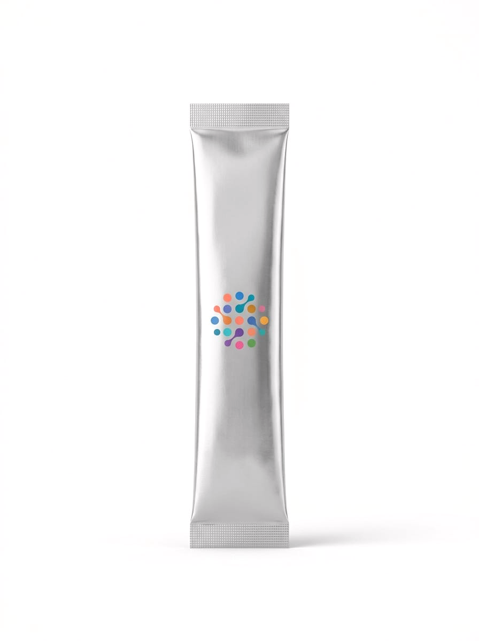
THE PRODUCT
One sachet. Your biology.
Delivered monthly.
Each sachet contains your personalised formulation — custom-compounded based on your biomarkers, DNA, and lifestyle data. Pharmaceutical-grade ingredients. Quarterly reformulation. Delivered to your door.
bioweave
CONFIDENTIAL
24

Slide 28
SECTION 05
Competitive Position
Why we win
bioweave
CONFIDENTIAL
25

Slide 29
COMPETITIVE LANDSCAPE
Optimised for You
IM8
BLUEPRINT
AGEMATE
BIOWEAVE
David Beckham
Bryan Johnson
Generic
You
✗
✗
✗
✓
✗
Partial
✗
✓
✗
✗
✗
✓
✗
✗
✗
✓
bioweave
CONFIDENTIAL
26

Slide 30
SECTION 06
Proof
What we've built
bioweave
CONFIDENTIAL
27

Slide 31
WE'VE BUILT IT
Not a concept. A working system.
Up to 400+ biomarkers analysed per user. 87% confidence scores on primary recommendations.
Every formulation includes a Safety Index with interaction checks, dose limits, and contraindication flags.
The AI engine is live. The formulation logic is proven.
Ingestion engine, profile gamification, security, dashboard, medical board, critic, synthetiser, chat with guard rails.
bioweave
CONFIDENTIAL
28

Slide 32
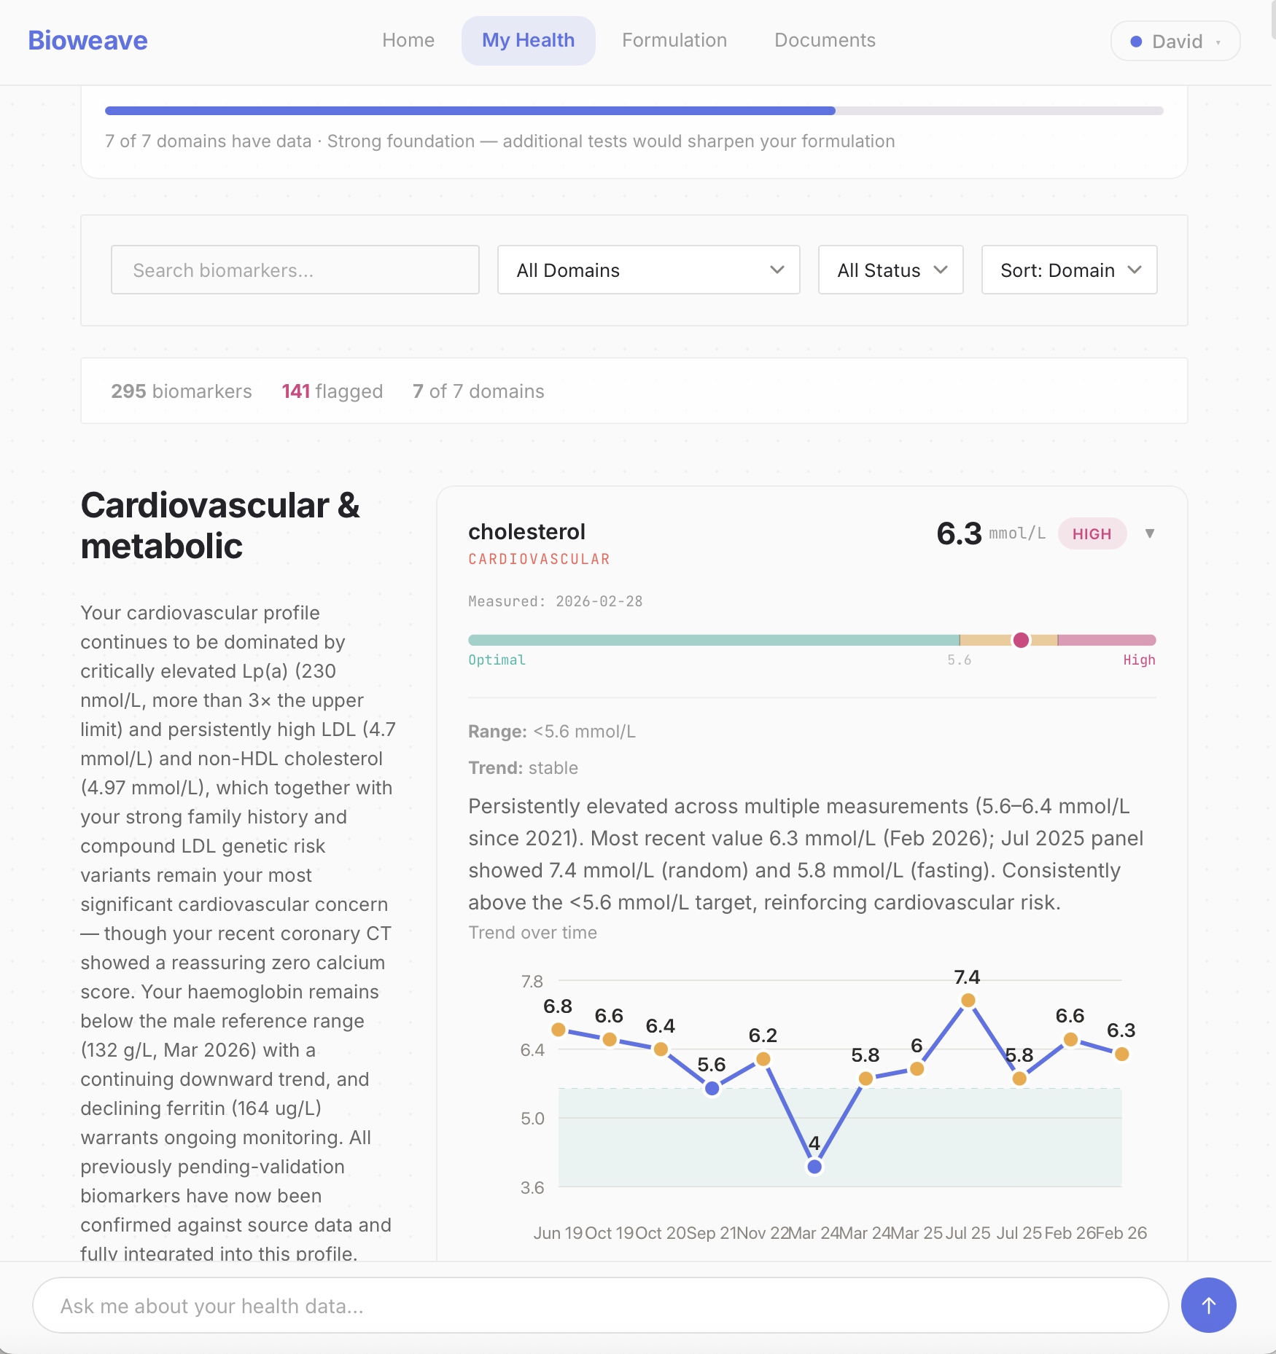
BIOWEAVE APP
The world’s most
advanced health
dashboard:
Unlimited biomarkers, DNA, wearables, imaging, physical assessments and user surveys, across seven domains.
bioweave
29

Slide 33
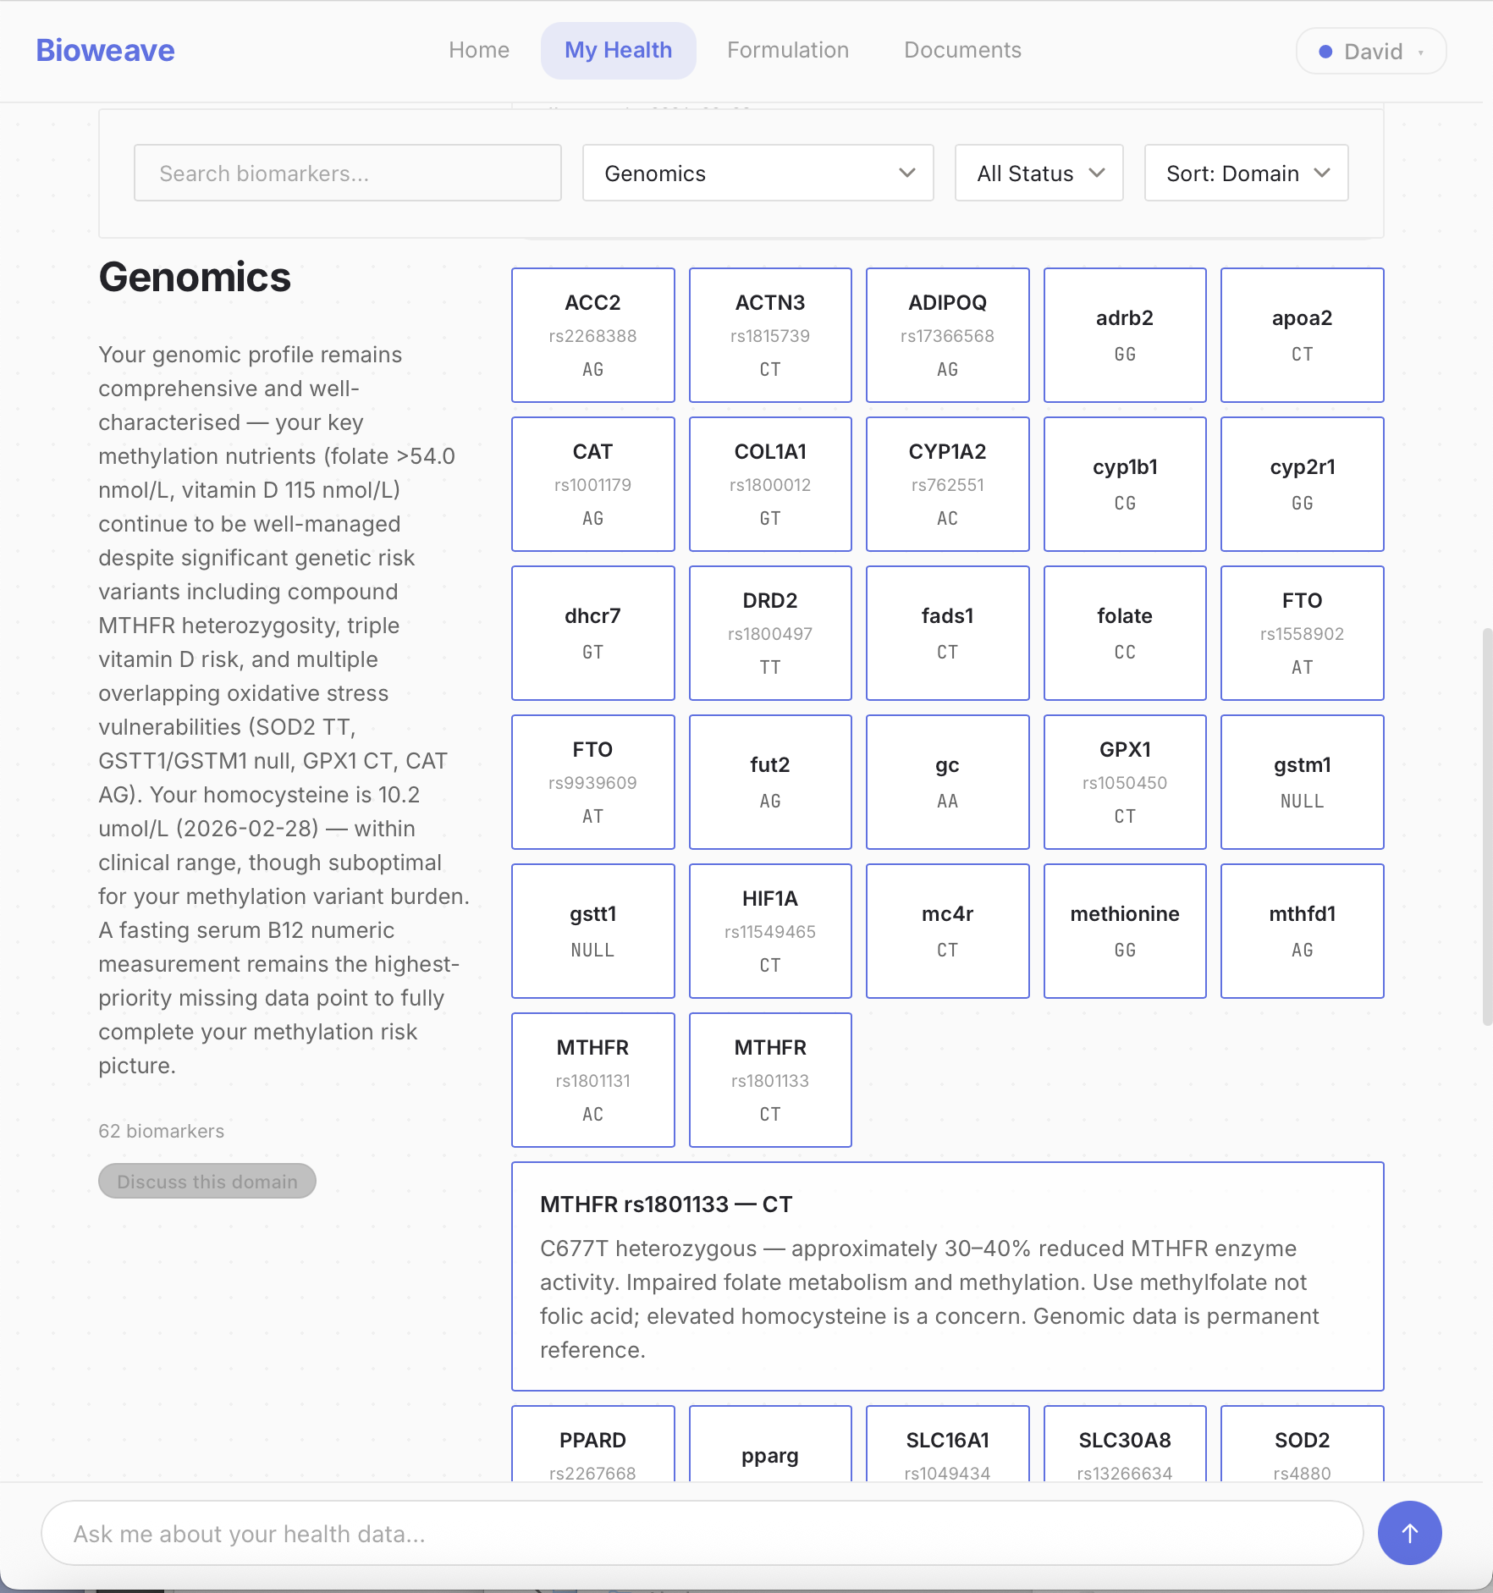
BIOWEAVE APP
The world’s most
advanced health
dashboard:
Unlimited biomarkers, DNA, wearables, imaging, physical assessments and user surveys, across seven domains.
bioweave
29

Slide 34
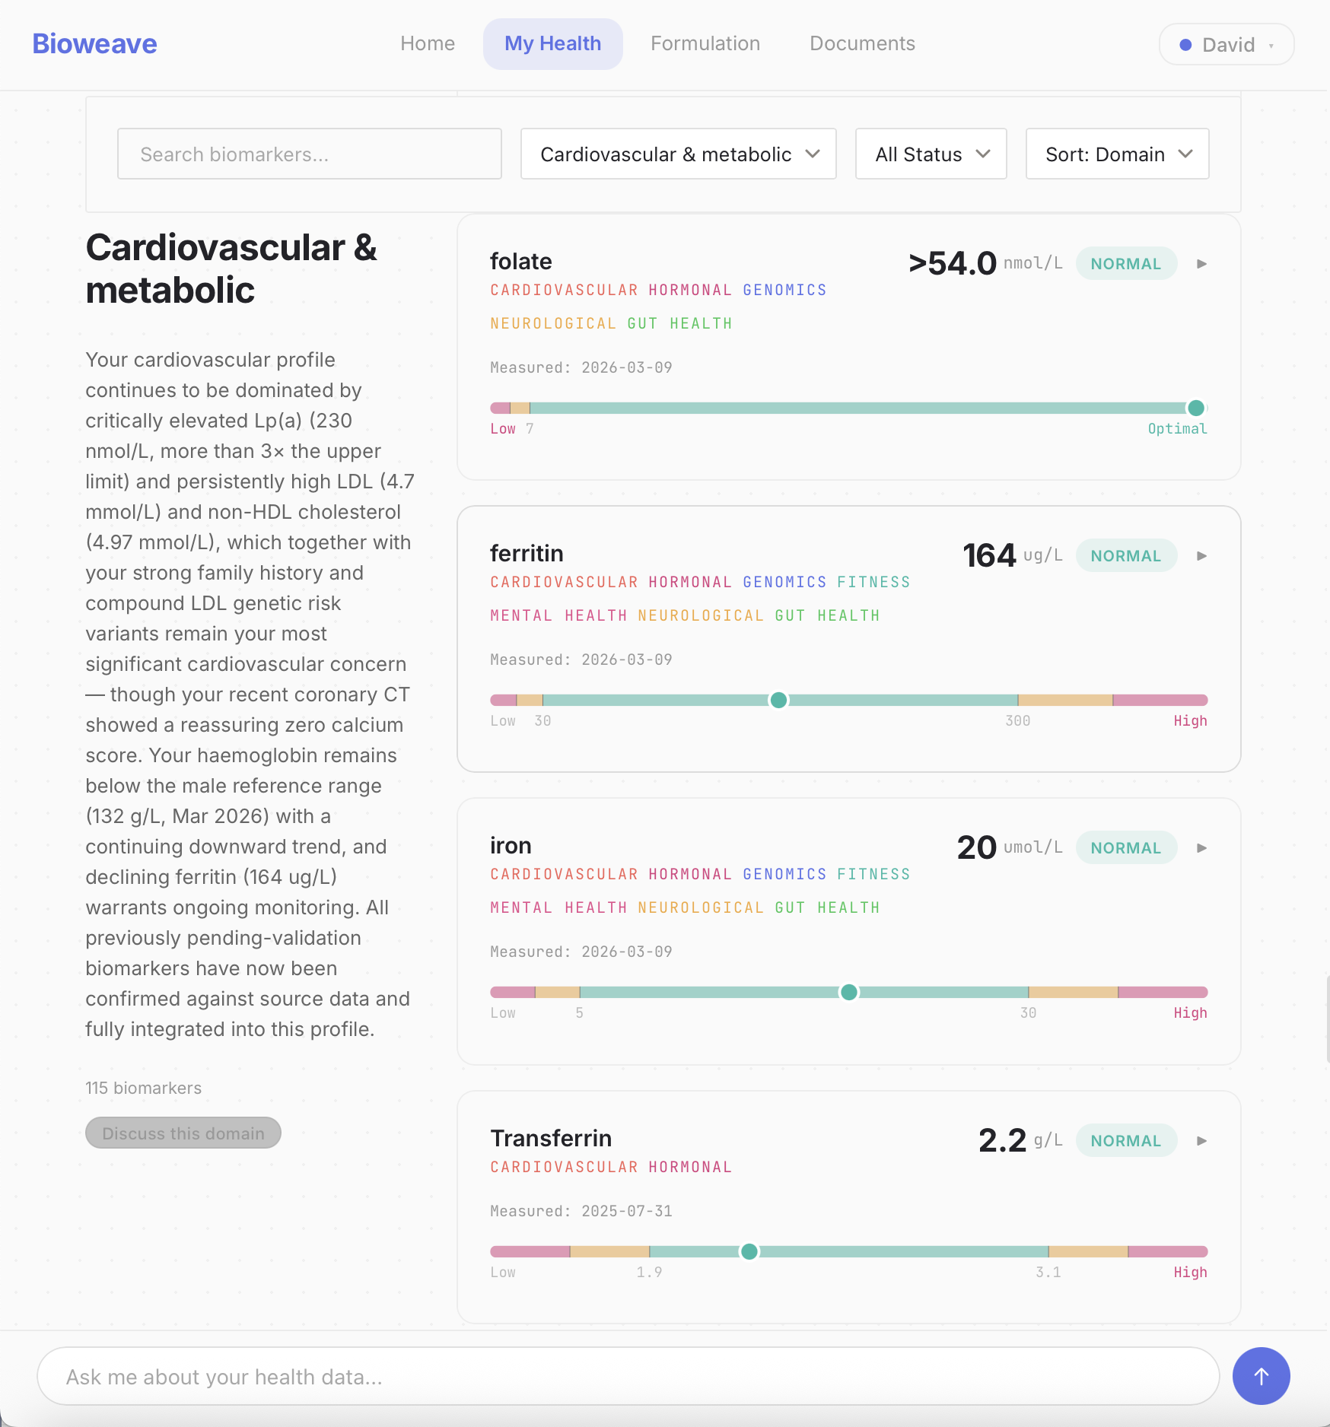
BIOWEAVE APP
The world’s most
advanced health
dashboard:
Unlimited biomarkers, DNA, wearables, imaging, physical assessments and user surveys, across seven domains.
bioweave
29

Slide 35
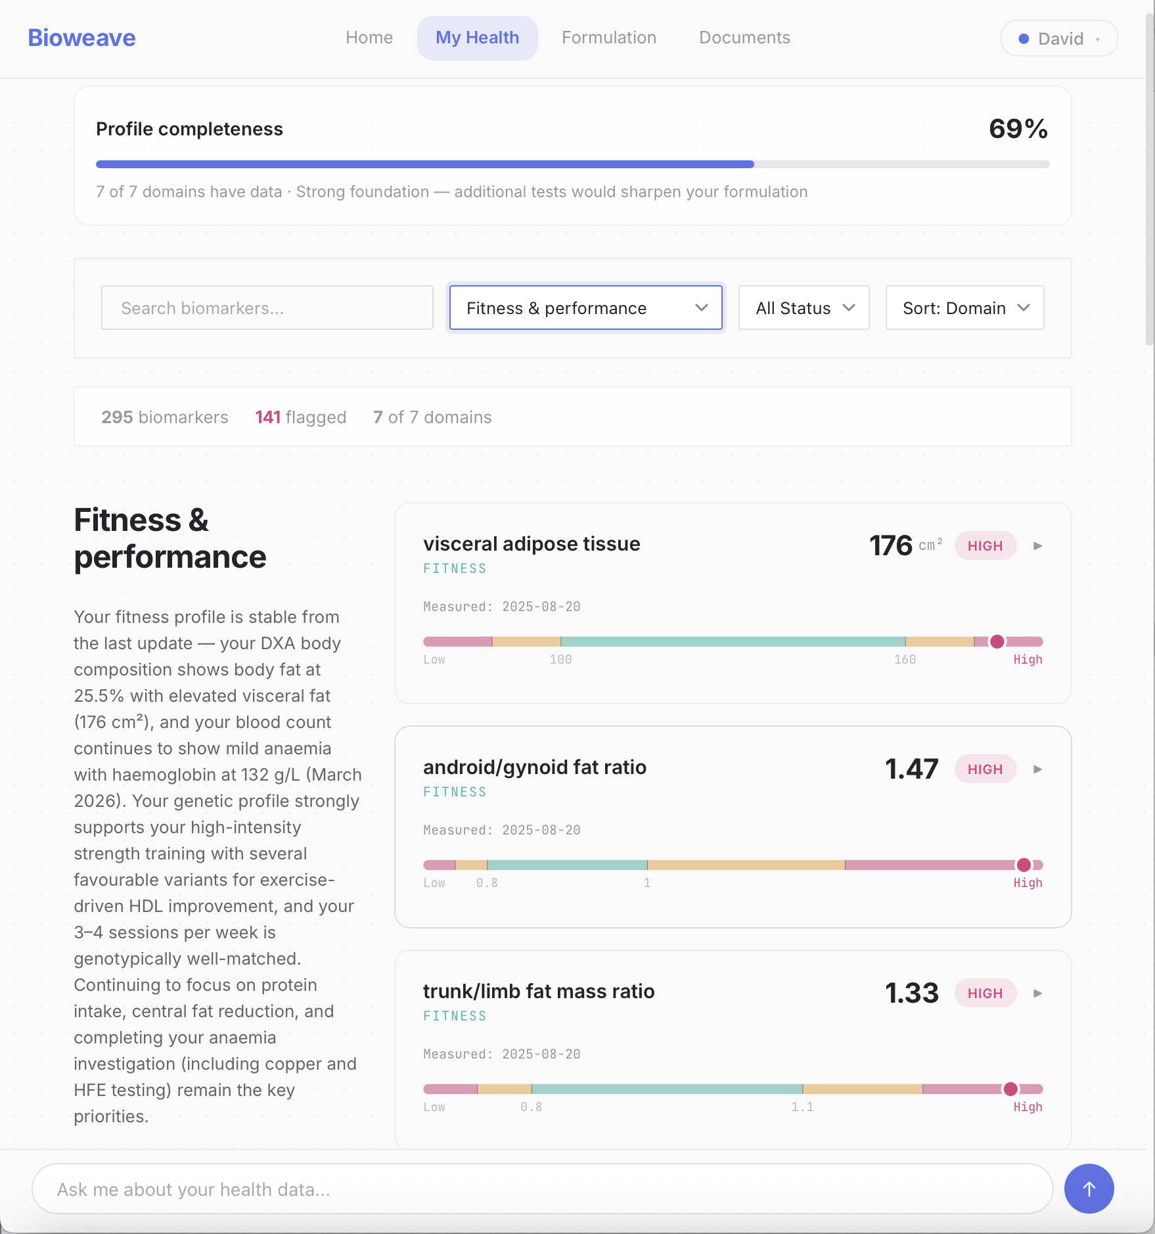
BIOWEAVE APP
The world’s most
advanced health
dashboard:
Unlimited biomarkers, DNA, wearables, imaging, physical assessments and user surveys, across seven domains.
bioweave
29

Slide 36
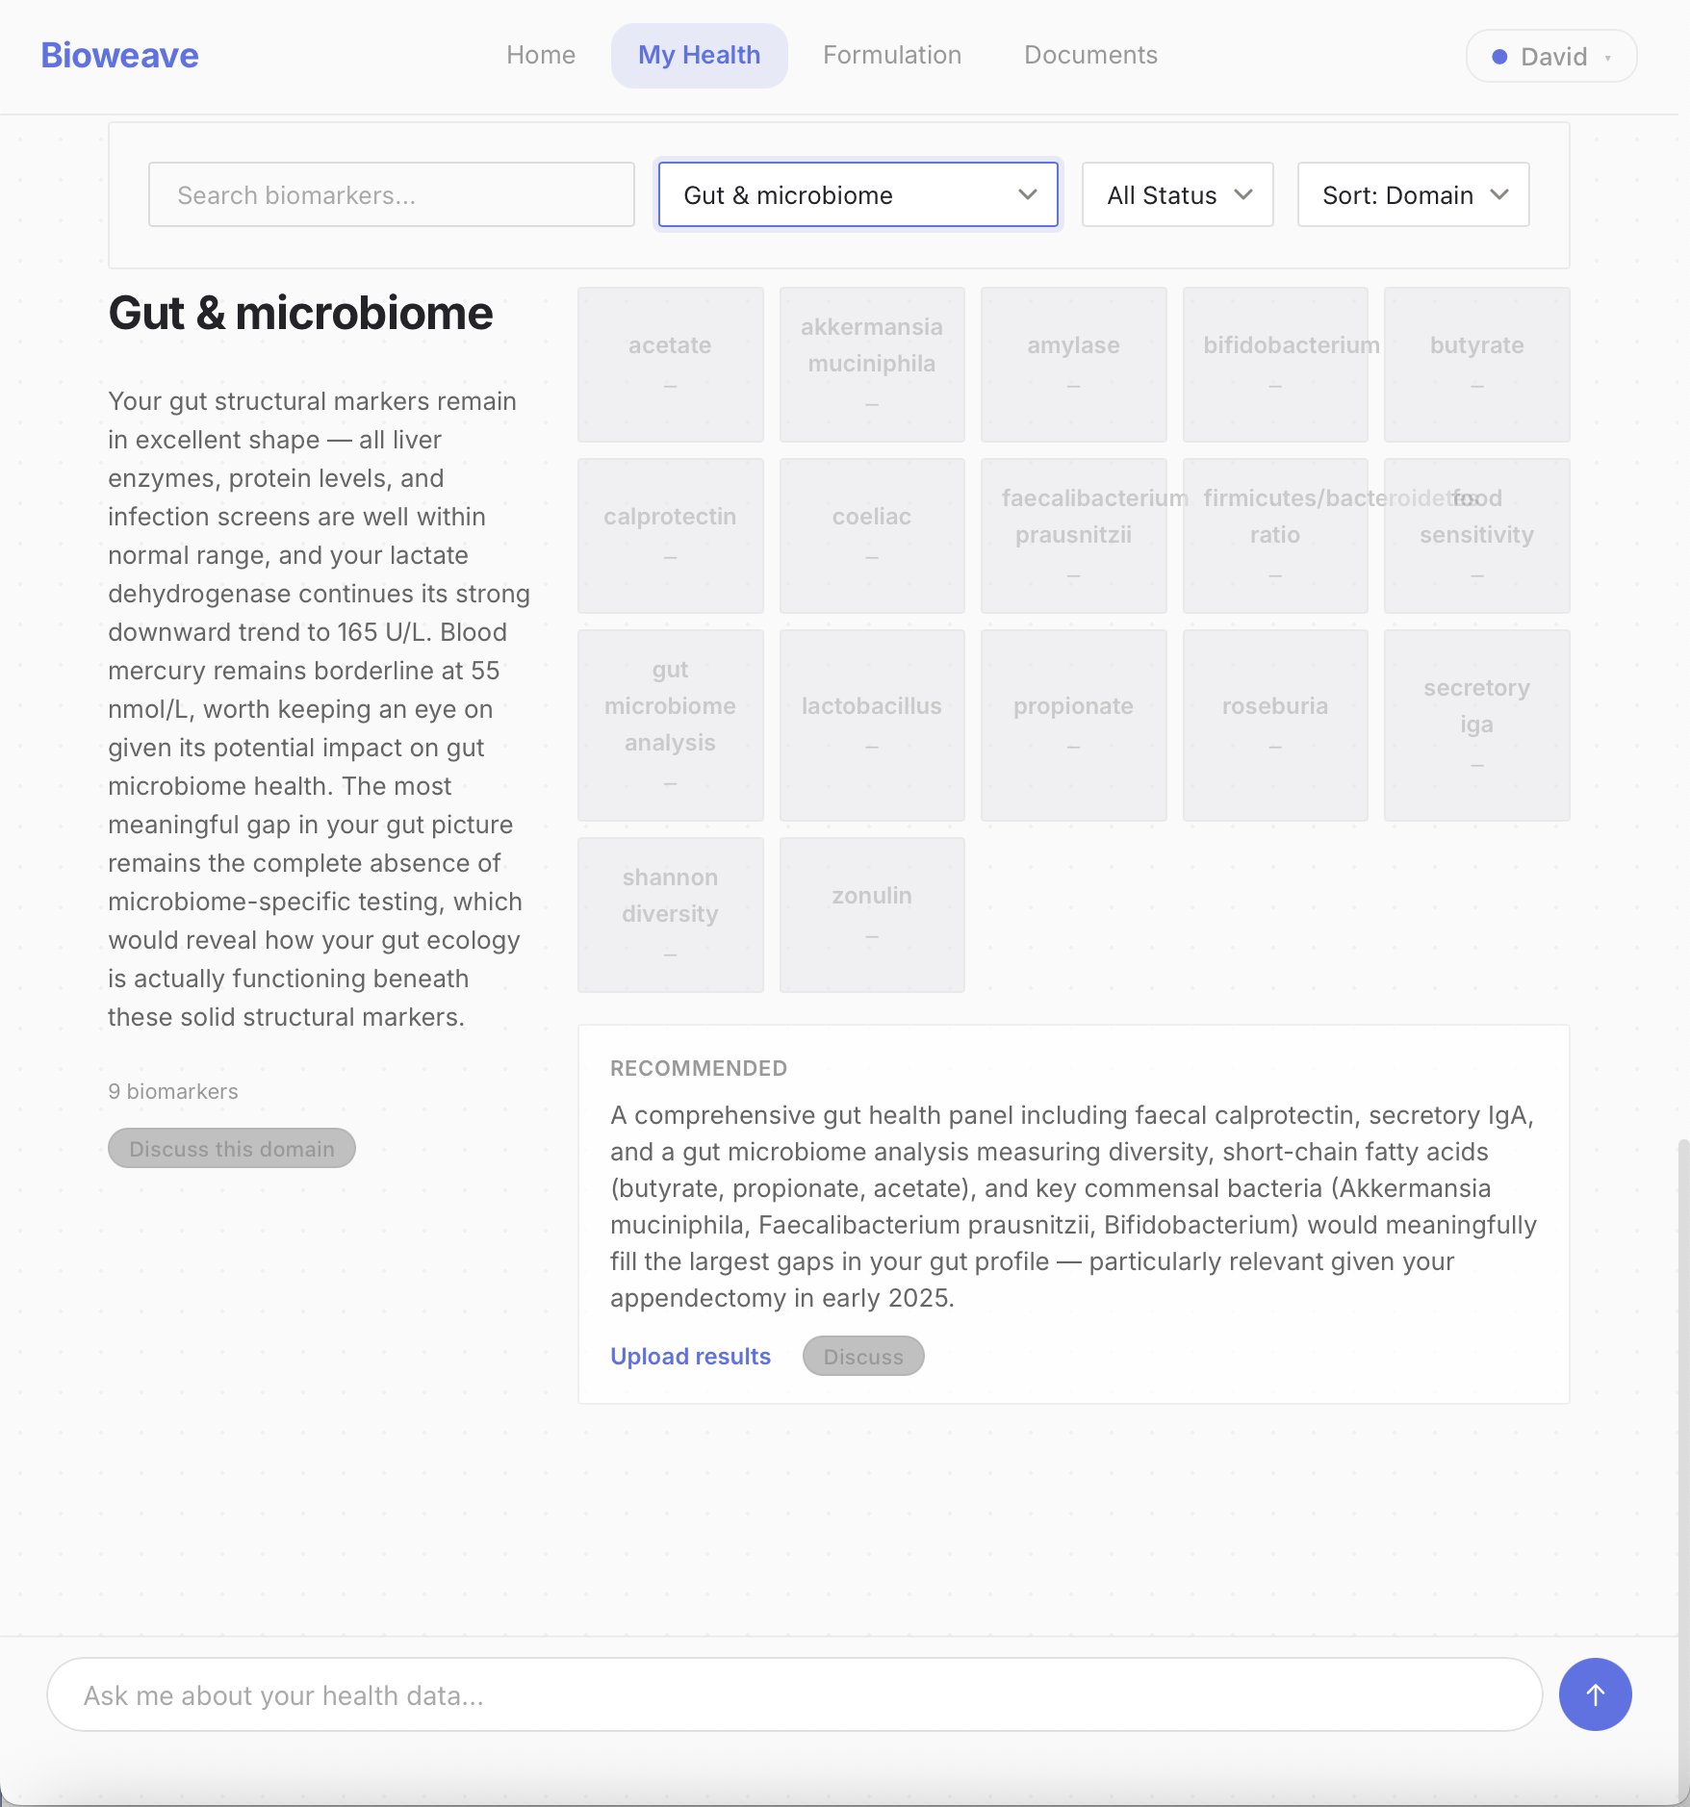
BIOWEAVE APP
The world’s most
advanced health
dashboard:
Unlimited biomarkers, DNA, wearables, imaging, physical assessments and user surveys, across seven domains.
bioweave
29

Slide 37
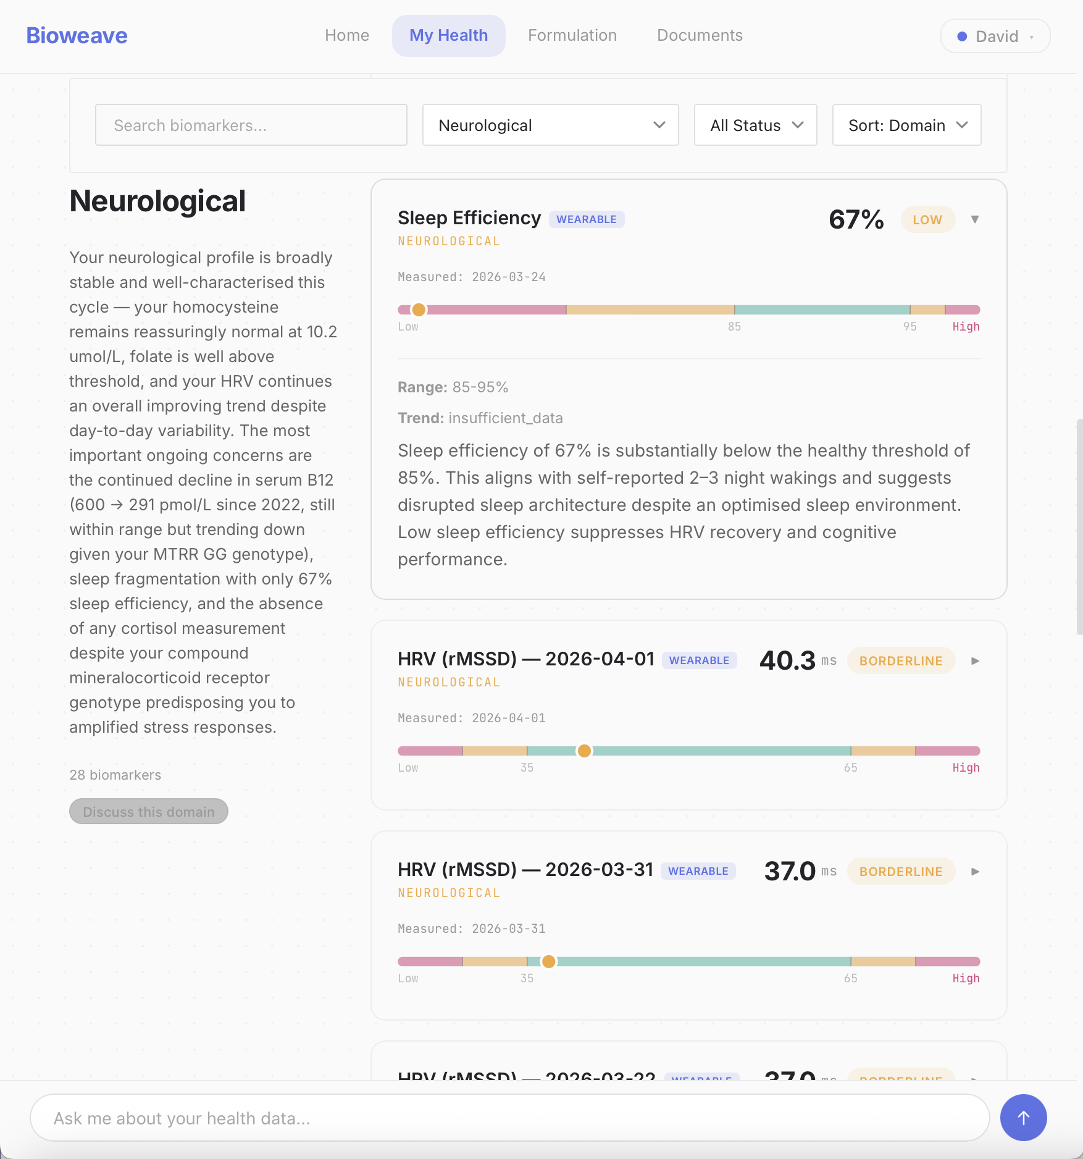
BIOWEAVE APP
The world’s most
advanced health
dashboard:
Unlimited biomarkers, DNA, wearables, imaging, physical assessments and user surveys, across seven domains.
bioweave
29

Slide 38
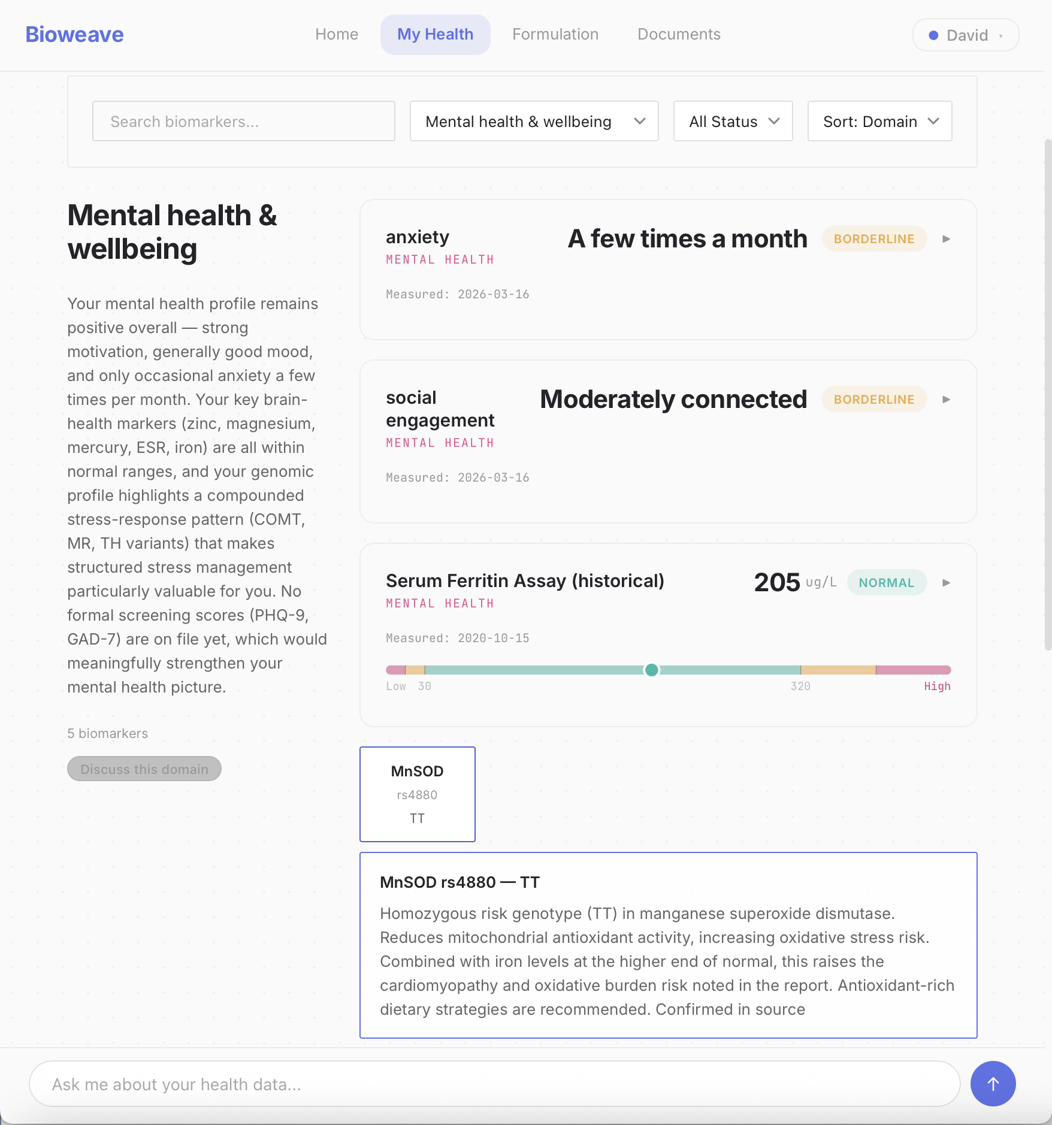
BIOWEAVE APP
The world’s most
advanced health
dashboard:
Unlimited biomarkers, DNA, wearables, imaging, physical assessments and user surveys, across seven domains.
bioweave
29

Slide 39
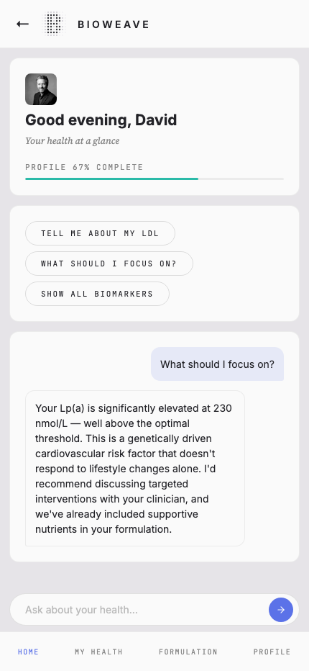
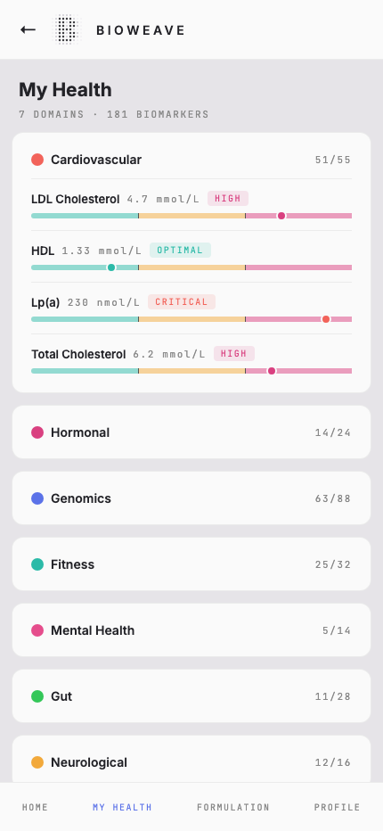
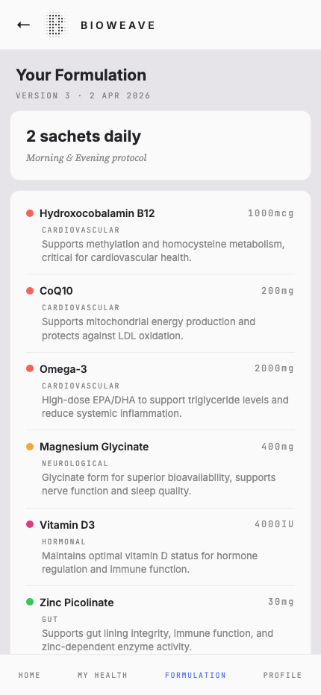
BIOWEAVE APP
Your health,
in your pocket
bioweave
CONFIDENTIAL
29

Slide 40
SECTION 07
What’s Next
Roadmap and ambition
bioweave
CONFIDENTIAL
30

Slide 41
NEXT STEPS
Action items
Brand
Product
Partnerships
• Marketing and launch plan
• Launch website and waitlist
• Content strategy: trust & science
• Ambassador programme
• Partnerships
• Beta formulation trials (Q2)
• Production system testing
• Regulatory review in Aus / USA
• Testing partners appointed
• Doctor / Pharmacist recruitment
• Manufacturing partner appointed
• Issue triage process
• App v1.0 release
• Strategic advisory board
• Human medical board
• Pathology lab integration
• Research partners
• Health practitioner network
bioweave
CONFIDENTIAL
31

Slide 42
NEXT STEPS
Building the Future
Product extensions
Data engine
Practitioner tools
• Expanded use cases
• Expanded product architecture
• further integrations
• Possible white label products
• Add on services (appointments, further testing, fitness, diet, community)
• Anonymised data feeds into the system to build intelligence
• Self improving system
• Doctor patient dashboard
• Onboaring via GP, IGP, Natropath
bioweave
CONFIDENTIAL
31

Slide 43
REGULATORY PATHWAY
Compliance by design, not afterthought.
AUSTRALIA (TGA)
Compounded medicine pathway — doctor-prescribed, exempt from ARTG
Every formulation reviewed by a registered doctor
AI positioned as clinical decision support, not decision making
Pharmaceutical-grade, GMP-compliant Australian manufacturing
Advertising compliant with TGA Code 2021
UNITED STATES (FDA / FTC)
503A compounding pathway — licensed practitioner + pharmacy
Doctor-in-the-loop satisfies practitioner requirement
All claims substantiated with peer-reviewed evidence
Positioned as personalised nutritional support, not treatment
State-by-state compounding regulations mapped
bioweave
CONFIDENTIAL

Slide 44
1,000,000
people by 2030
One million people with formulations built for their biology.
Not a celebrity’s. Theirs.
bioweave
CONFIDENTIAL
32

Slide 45
B I O W E A V E
Individual biology, illuminated.
April 2026 | Confidential

